Slide 1
THE
Fabulous Fruit & Veg QUIZ

Slide 2
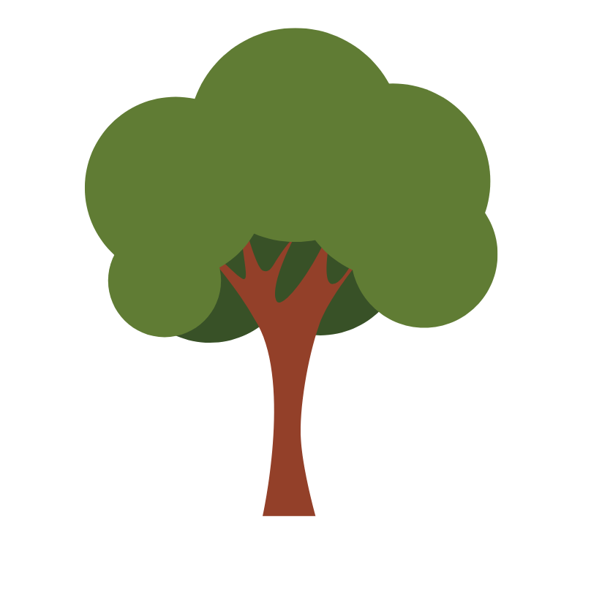
Question 1
What are some fruits that grow on trees?
Apples
Pears
Oranges
Mangoes
Lemons
Guavas

Slide 3
Question 2
Does all fruit grow on trees?
A. Yes
B. No
Some fruit like grapes grow on vines. Some grow in shrubs like blueberries.

Slide 4
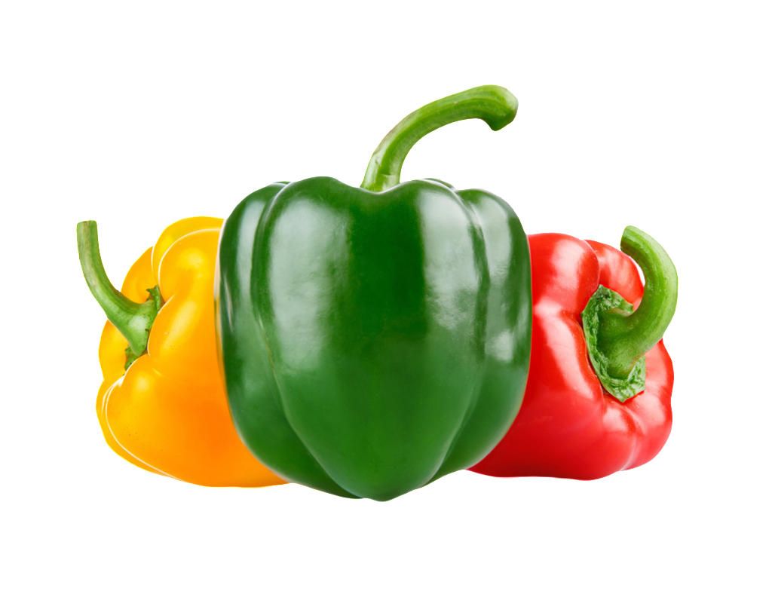
Question 3
What vegetable can come in yellow, green or red?
A. Carrots
B. Zucchini
C. Capsicum

Slide 5
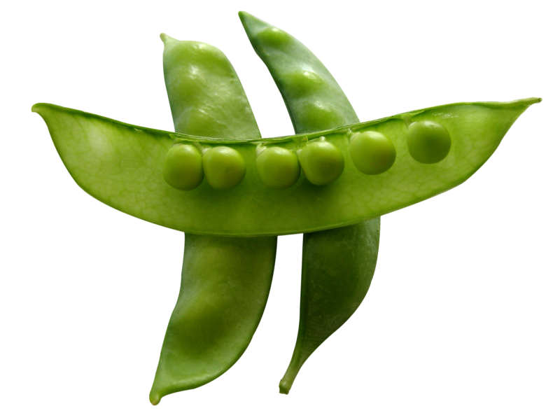
Question 4
What vegetable grows in a pod
A. Peas
B. Corn
C. Broccoli

Slide 6
Question 5
When are strawberries in season?
A. Winter
B. Summer
C. Autumn

Slide 7
Question 6
Carrots are full of vitamin A.
Vitamins A helps us
A. Keep our mouth healthy
B. Keep our nose healthy
C. Keeps our eyes healthy

Slide 8
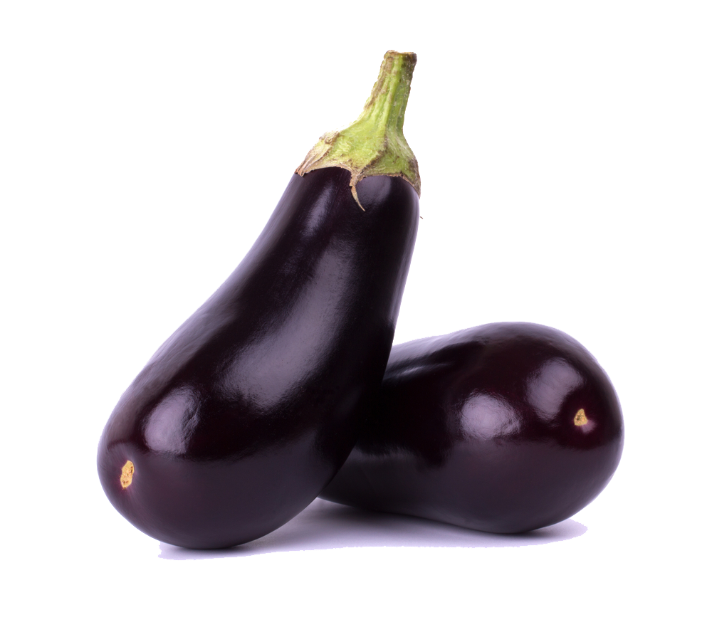
Question 7
Fun fact:
It’s called an eggplant because thousands of years ago, it looked like an egg! It was much smaller!
What is this vegetable?
A. Leek
B. Kale
C. Eggplant

Slide 9
Question 8
What are some good things about eating food that is ‘in season’?
The fruit and vegetables are tastier
It’s good for the environment
We are supporting local farmers

Slide 10
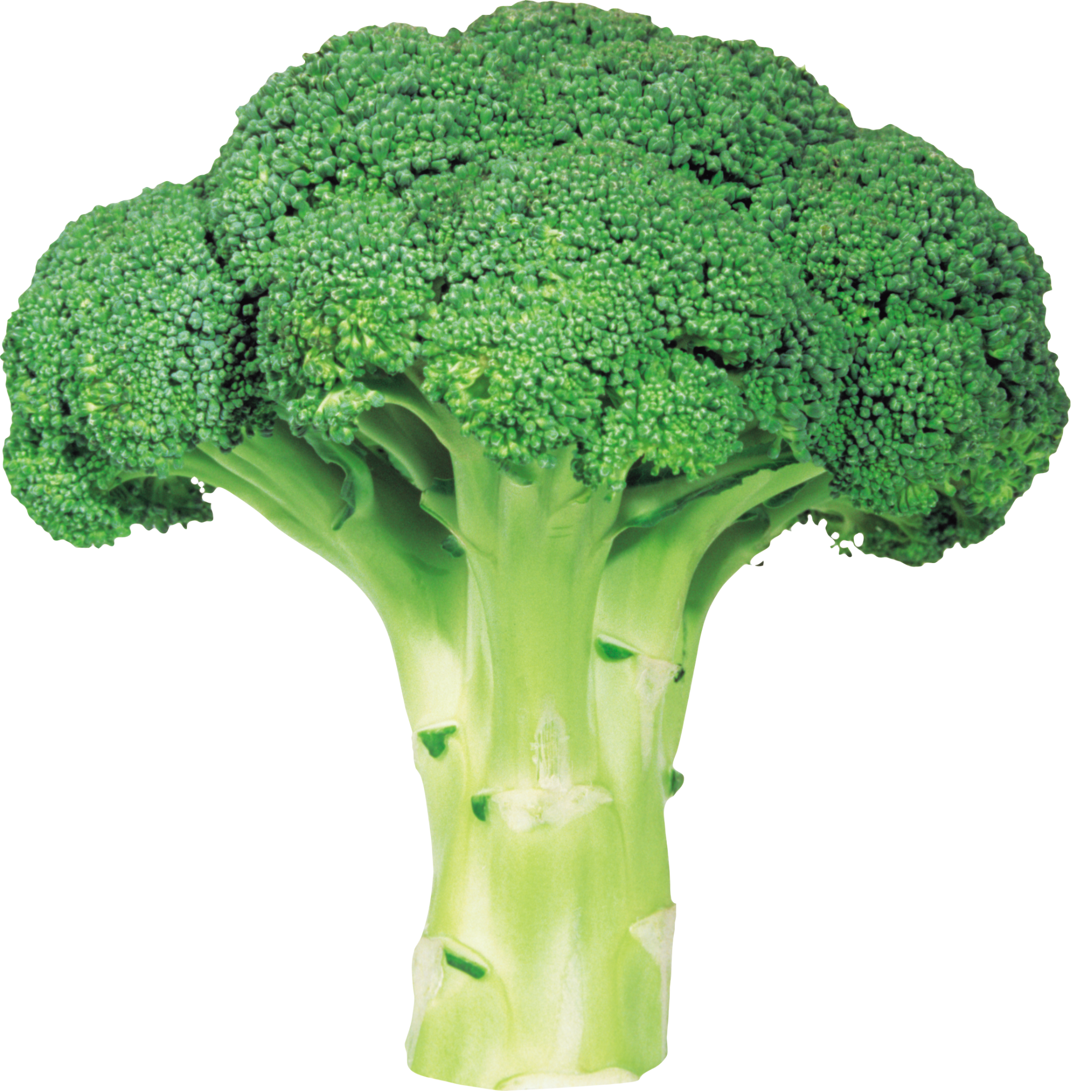
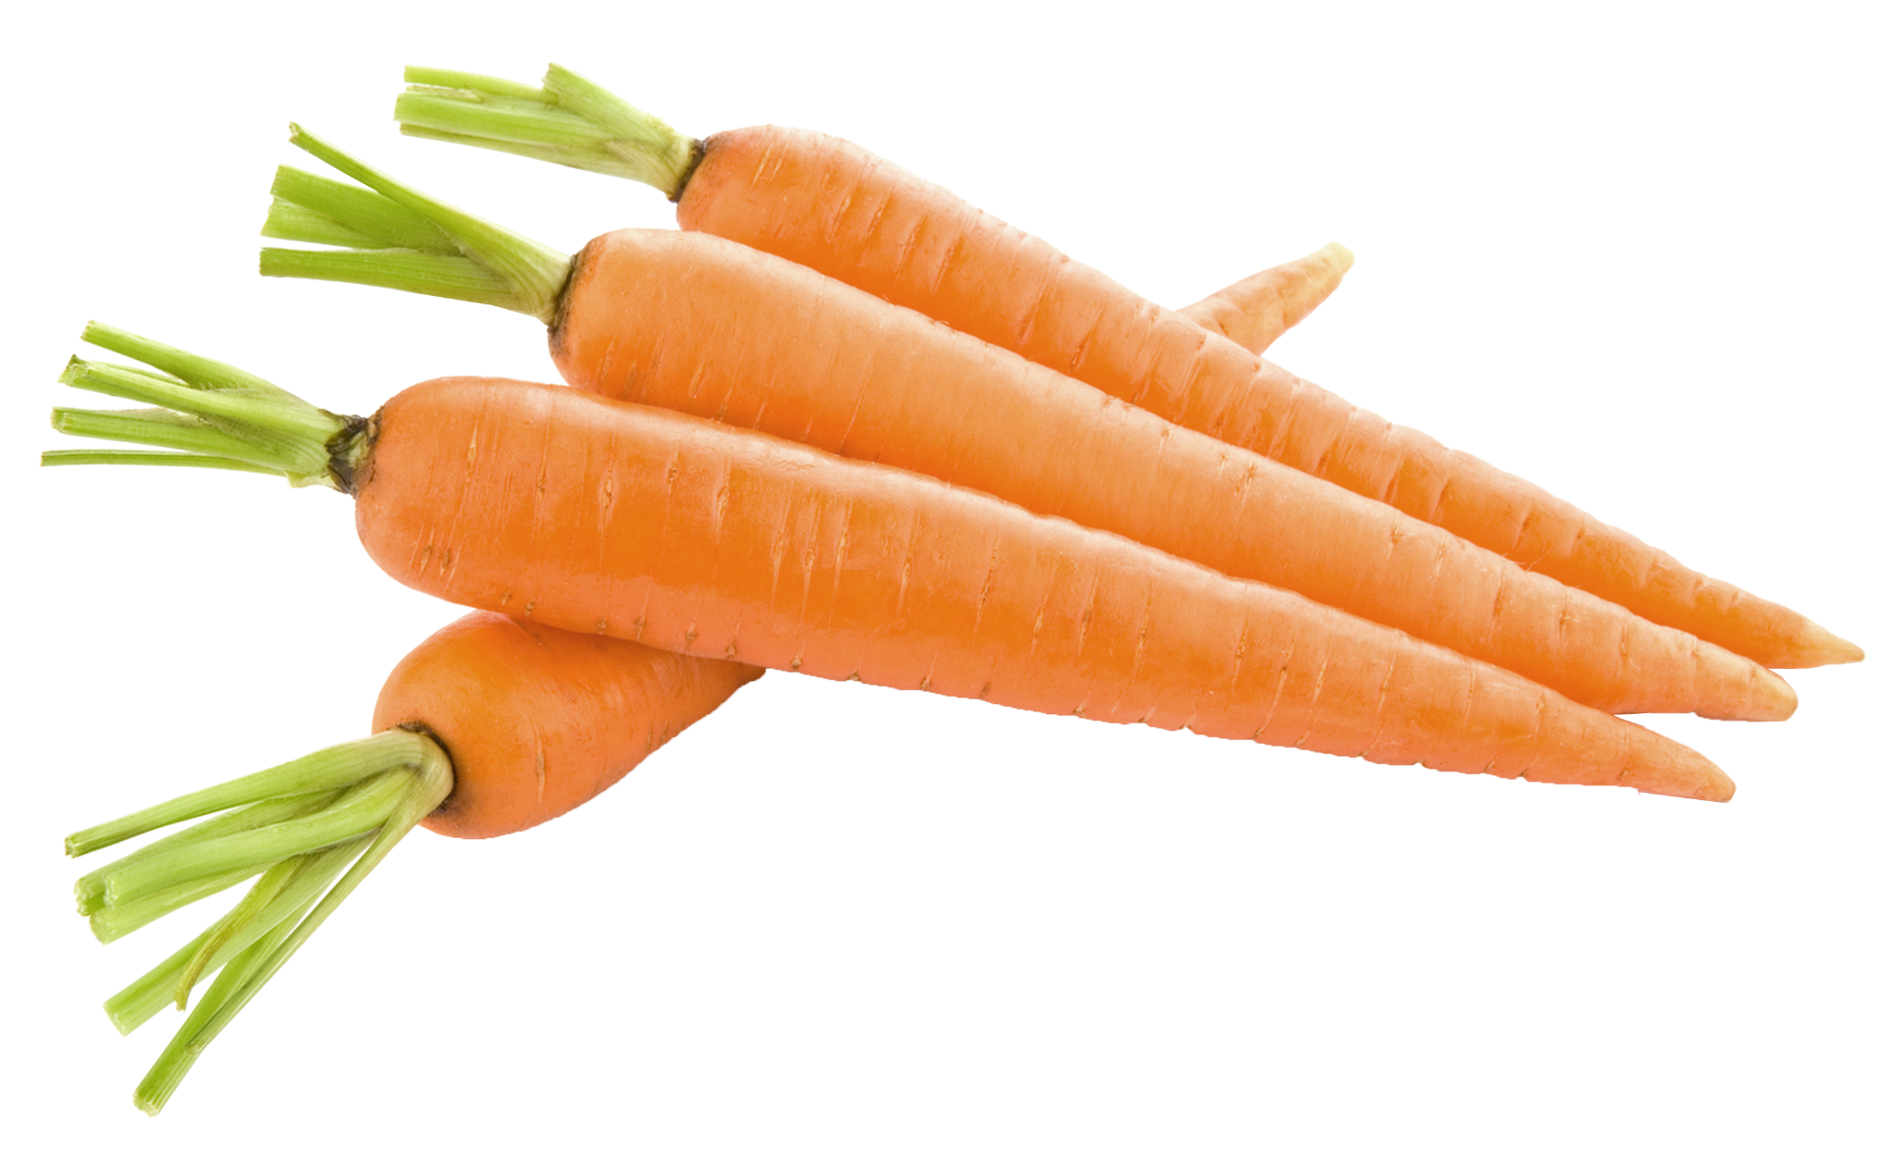
Question 9
True or false: Can you eat these vegetables raw?
A. True
B. False

Slide 11
Question 10
What are ‘food miles’?
A. The distance food travelled from where it is produced, to where it is eaten
B. The distance food travelled from the supermarket to where it is eaten
C. The time it takes for a food to grow

Slide 12
Question 11
What can you do at a community garden?
A. Grow food together with others
B. Learn how to grow food
C. Make friends and relax
D. All of the above

Slide 13
Question 12
What is the difference between a fruit and vegetable?
A. A fruit has seeds, while a vegetable never has seeds
B. A fruit is always sweet in flavour, while a vegetable is always bitter
C. A fruit grows from the flower of the plant, the other parts of a plant are can be a vegetable

Slide 14
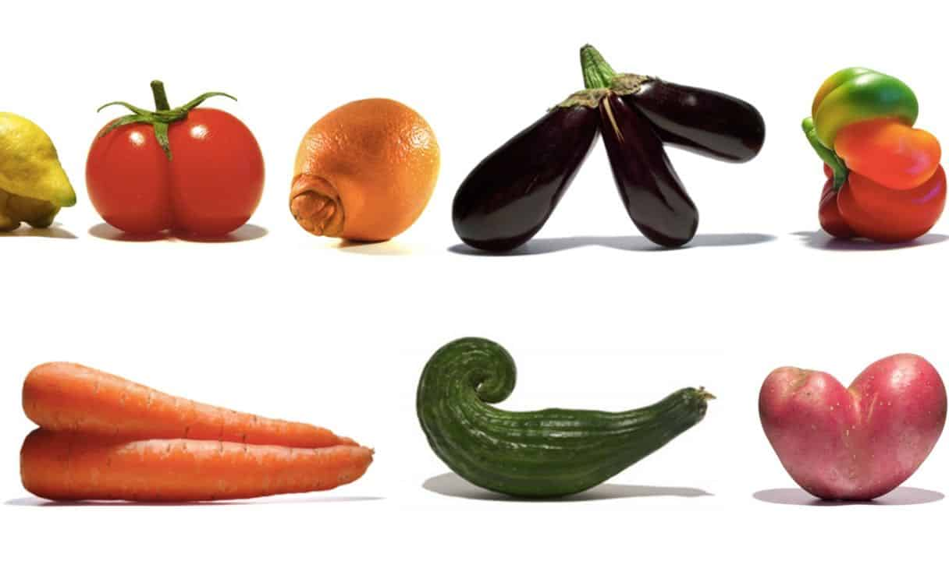
Question 13
These fruits and vegetables have unusual shapes, can you still eat them?
A. Yes
B. No

Slide 15
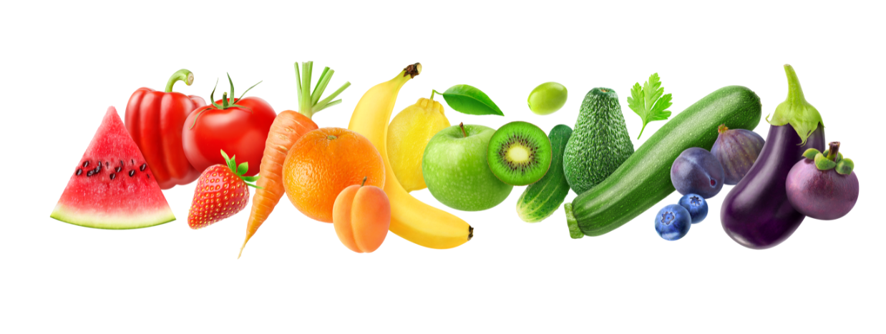
Question 14
What does it mean to ‘eat the rainbow’?
A. We should only eat one colour of a fruit or vegetable per day
B. We should eat fruits and vegetables of all different coulours
C. We should eat lollies of different colours

Slide 16
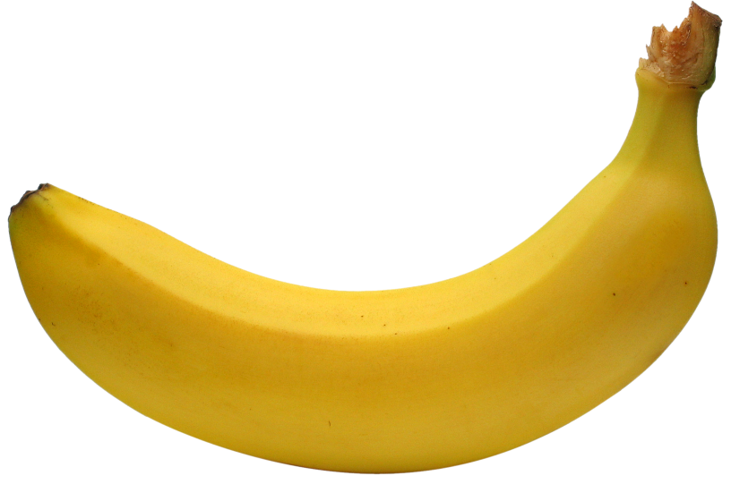
Question 15
Banana trees don’t grow on the north pole… why?
A. Banana trees need a warmer climate to grow
B. It never rains on the north pole, and banana trees need a lot of water
C. Polar bears don’t like bananas

Slide 17
Question 16
Why is it a good idea to eat food grown locally?
A. The food is fresh
B. We can support our local community
C. It is good for the environment
D. All of the above

Slide 18
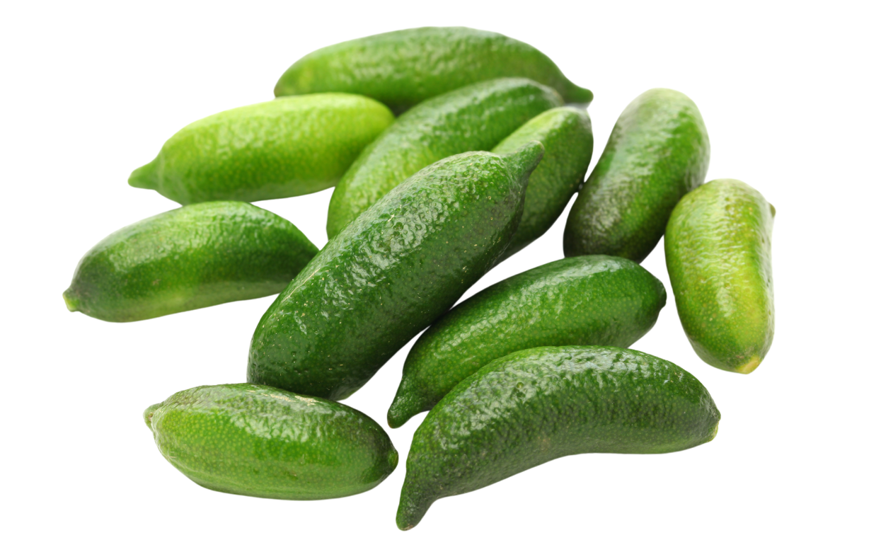
Question 17
Bush foods are foods that are native to Australia. What is an example of a bush food?
A. Finger limes
B. Green apples
C. Brussel sprouts

Slide 19
Question 18
‘Bush foods’ are often also referred to?
A. Bush tucker
B. Traditional Aboriginal food
C. Both A and B

Slide 20
Question 19
True or false: you can eat any bush food you find in
the wild.
A. True: All foods you can find in the wild are safe to eat
B. False: It can be very dangerous to eat foods in the wild. Some can be toxic and make you sick. You should always ask an expert for advice

Slide 21
Question 20
Which of these do you need to grow fruit and vegetables?
A. Seeds
B. Soil
C. Water
D. All of the above

Slide 22
Fun Food Facts
Did you know that…
A pineapple is neither a pine or apple, but actually a berry?!
Same for bananas and watermelon, but a strawberry is not a berry! 🤔
Cucumbers are 95% water
Fruit salad trees exist and can grow different fruits on one tree
The original carrots were purple and yellow, not orange

