Slide 1
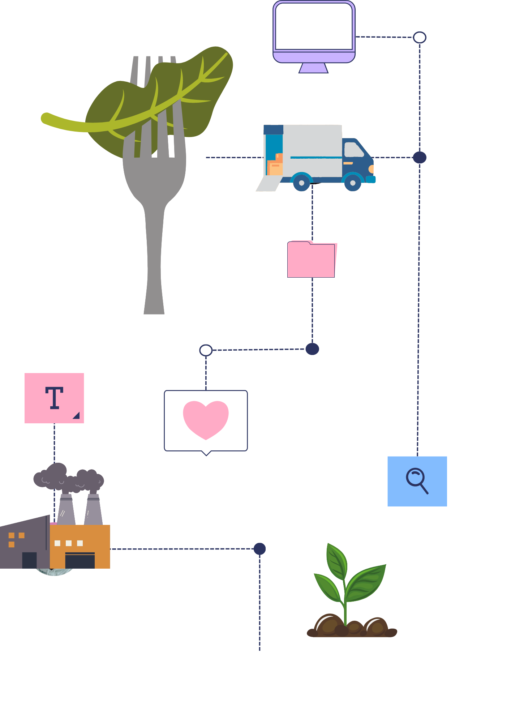
PPT2
From farm
to fork
Fruit & Veg Month 2023

Slide 2
What do we mean when we say 'From farm to fork'?
It’s how fruits or vegetables travel from the farm to your shop or home. The farm is where it grows and home is where it ends up on your fork to eat!
This is also called the supply chain. Different types of fruits and vegetables have their own steps.
Have you ever thought about where your Crunch & Sip fruit/veg came from and how it made it into your lunchbox?

Slide 3
What is the process?
Most of the fruits and vegetables we eat come from a farm far away. Here they grow and harvest the fruit/veg.
In a 'sorting centre', the fruit/veg get sorted and packaged. Not all the fruit/veg will go to the shops - some might only be good enough for salads, jam or even too bad to eat. Some will go to shops, some to farmers markets and some to restaurants.
Then the fruit/veg gets transported all over the world! Depending on how far, it might travel by train, ship, truck or even plane.
Or maybe even all of them!
The fruit/veg is transported to shops, farmers markets, school canteens and many more places! That's how it ends up in your lunchbox or 'on your fork'!

Slide 4
Some important points about the Farm to Fork process
The process needs to happen quickly!
What do you think will happen if the process takes to long?
Not all fruits and vegetables are harvested in the same way.
Do you know what are some different ways to harvest? For example bananas versus carrots?
Not every fruit or vegetable follows the same path or process. In the sorting centre it is decided where the fruit or vegetable will be transported to or what it will be used for
What do you think fruits and vegetables are sorted for?
Some of the fruits or vegetables will be transported to local places, and some might even go internationally!
What is 'local'? And why do some go international?
Can you think of a reason?
The process need to happen safely!
What do you think that means?

Slide 5
Harvest
On the farm, fruits and vegetables are grown and then harvested. This often happens with big machines, so the process is very quick. But not all are harvested in the same way of course! Some are still picked by hand.
Have a look at carrots versus bananas.
This way they stay fresh and only ripen whey get to
the store! (Think green bananas).
Play GIFS

Slide 6
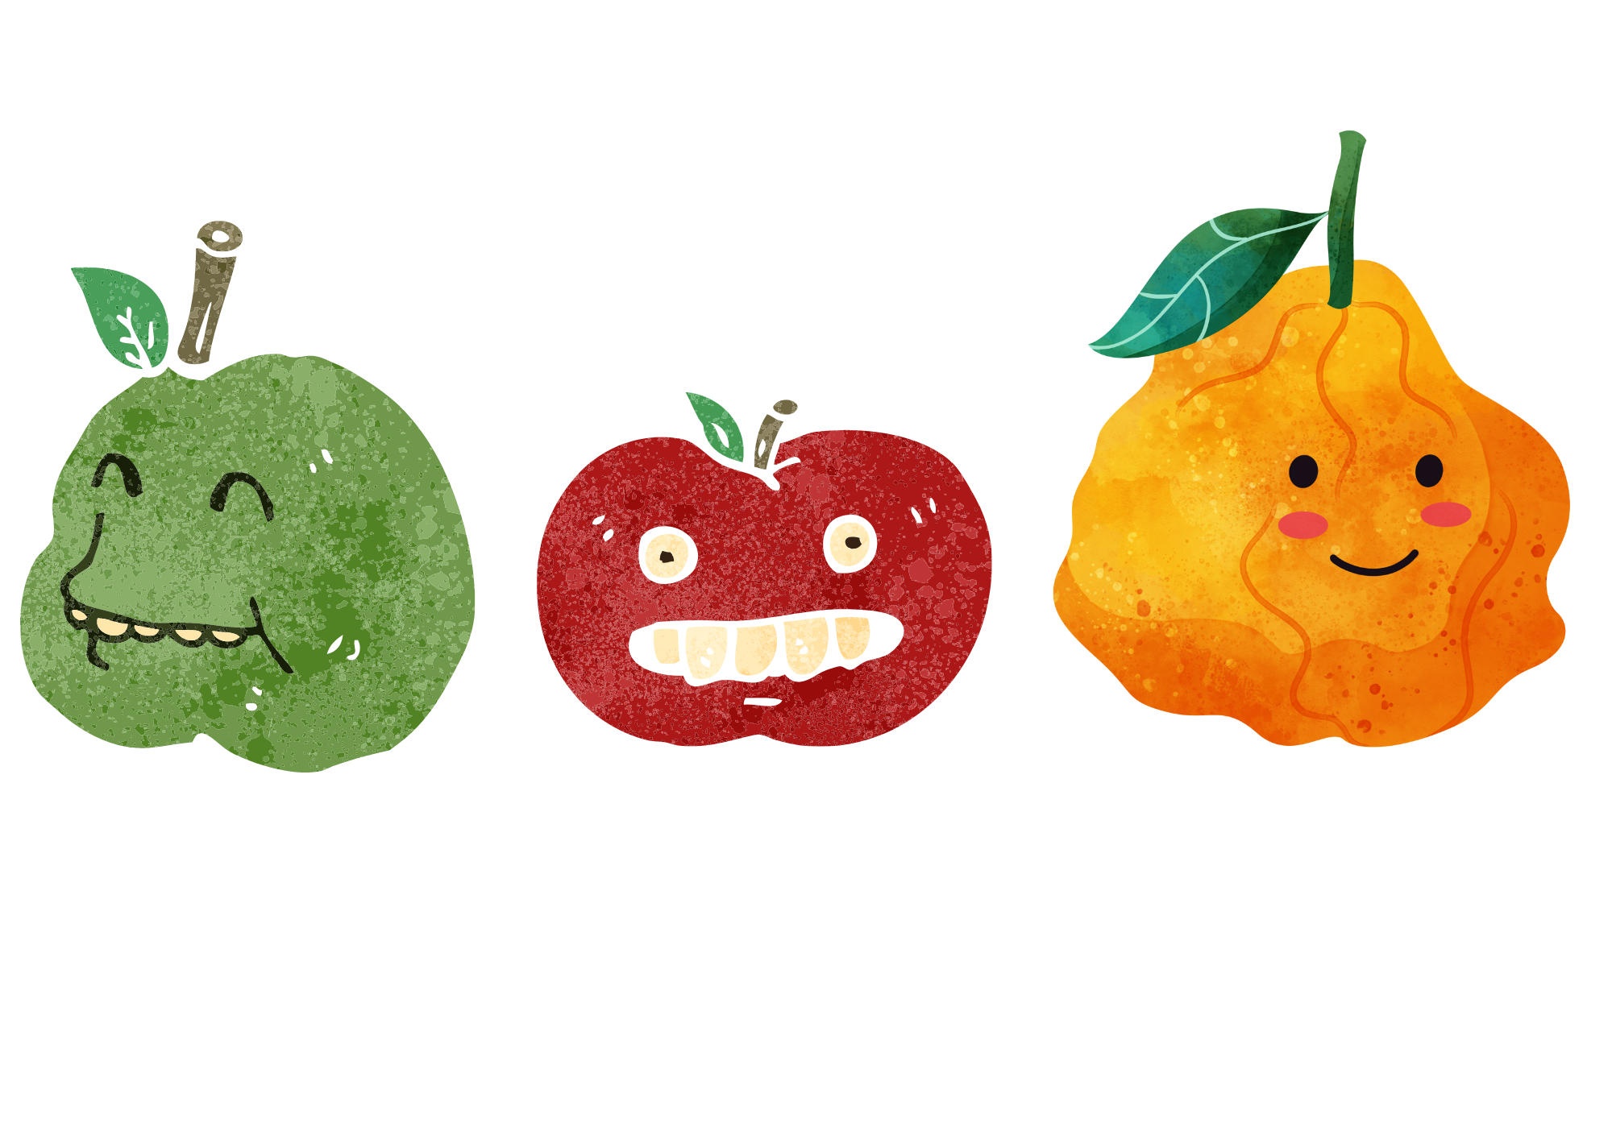
Sorting centre
Not every fruit or vegetable that is harvested is deemed good enough to go to the shops or be sold elsewhere. Some are odd-shaped and will be used for other things like jams, pre-cut fruit or veggie bags, soups, babyfood or even dog food!
Some might also be thrown out: they might be too small, have a weird shape or colour, or are not good to eat because they have a bug in them or have been affected by a disease.

Slide 7
Transport
The fruits and vegetables are transported to local, nation-wide and sometimes even international sellers! Depending on where they go, they are transported by refrigerated trucks, trains, container ships or even planes. To makes sure the produce does not get damaged from all the humps and bumps, they are packaged in soft materials and in pallets.
https://www.youtube.com/watch?v=dBcyDIhbNes

Slide 8
Food safety
The Farm to fork process needs to happen safely! Just like you need to wash your hands before eating, the fruits and vegetables cannot become very dirty, rotten or have any dangerous chemicals or bacteria on them. Food safety is important at every step of the supply chain. There are several ways to keep the fruits and vegetables safe:
They are washed, to remove pesticides and dirt
They are kept cold (also during transport!)
Sometimes gas (such as CO2) is used to keep the produce fresh and bug free
Workers wear gloves and masks and visually inspect the produce
From each batch of produce, a sample is taken and tested for any
bugs, chemicals, viruses or bacteria.
You need to be aware of food safety at home too!
Where do you store your fruits and vegetables?
Do you ever visually inspect before eating?
Do you wash your hands and fruit/veg before eating?
What happens if you do not safely store and prepare your
fruits and vegetables?

Slide 9
Food safety at home

Slide 10
Flowcharts
We can use a flowchart to show how different fruits and vegetables make it from ‘farm to fork’. A flow chart can show you the steps from start to end in one picture.
Flowcharts can have different paths for different steps along the way.
Have a look at the flowchart for carrots making it from farm to fork on the next page.

Slide 12
More to think about (for the higher stages)
Can you think of any way to increase the yield of harvest?
Can you think of any way to grow fruits or vegetables in environments that are usually not suitable (for example when it's too cold)?
Food waste is a global problem! At any stage of the supply chain there is food waste. Why and how? What can we do to prevent food waste?
What is 'rotting' or 'fermenting'? Why do fruits and vegetables sometimes rot or ferment? What can you do to prevent this? Have a look at old versus current ways to slow these processes.
Why are shorter supply chains more environmentally friendly than longer ones?

Slide 13
Flowcharts expert level (for extension in the higher stages)
Professional flowcharts will usually have different shapes (see below). Each shape has a different meaning (see next page).

Slide 15
https://www.youtube.com/watch?v=SWRDqTx8d4k&t=2s

