Slide 1
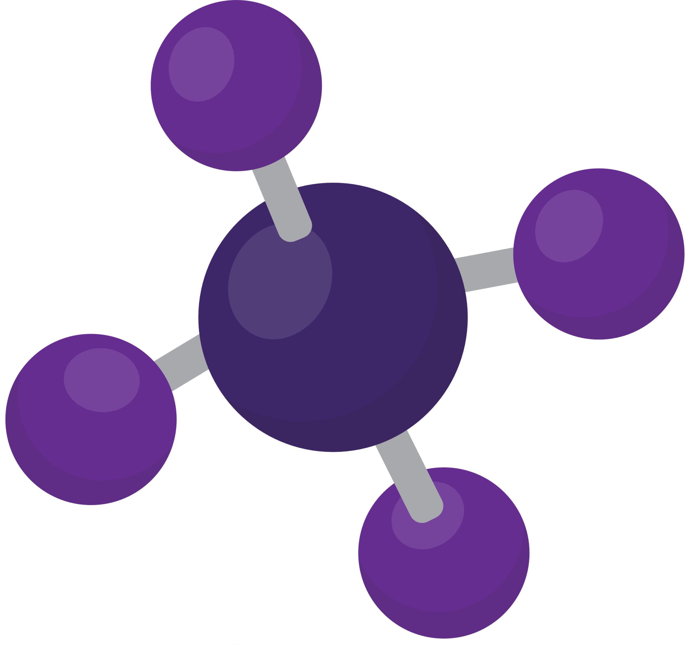

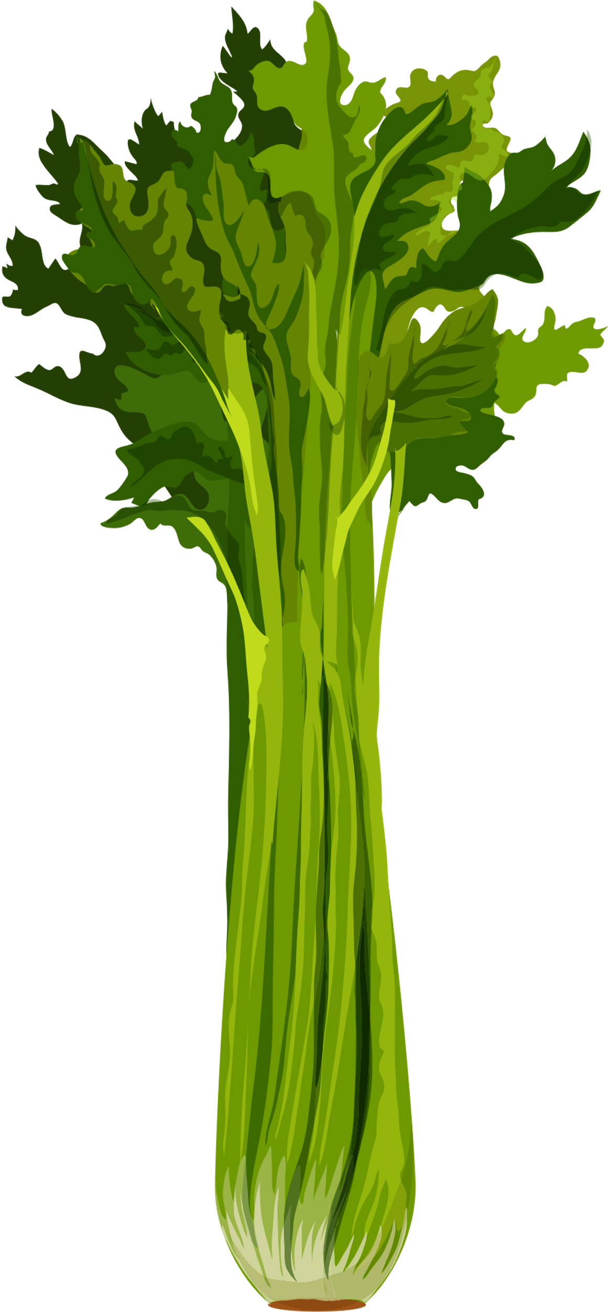

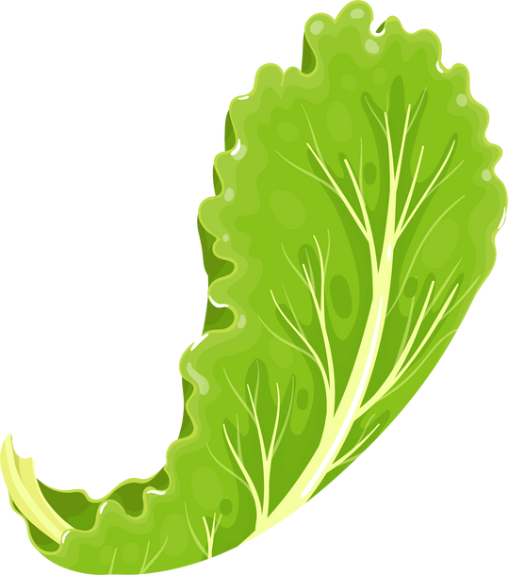
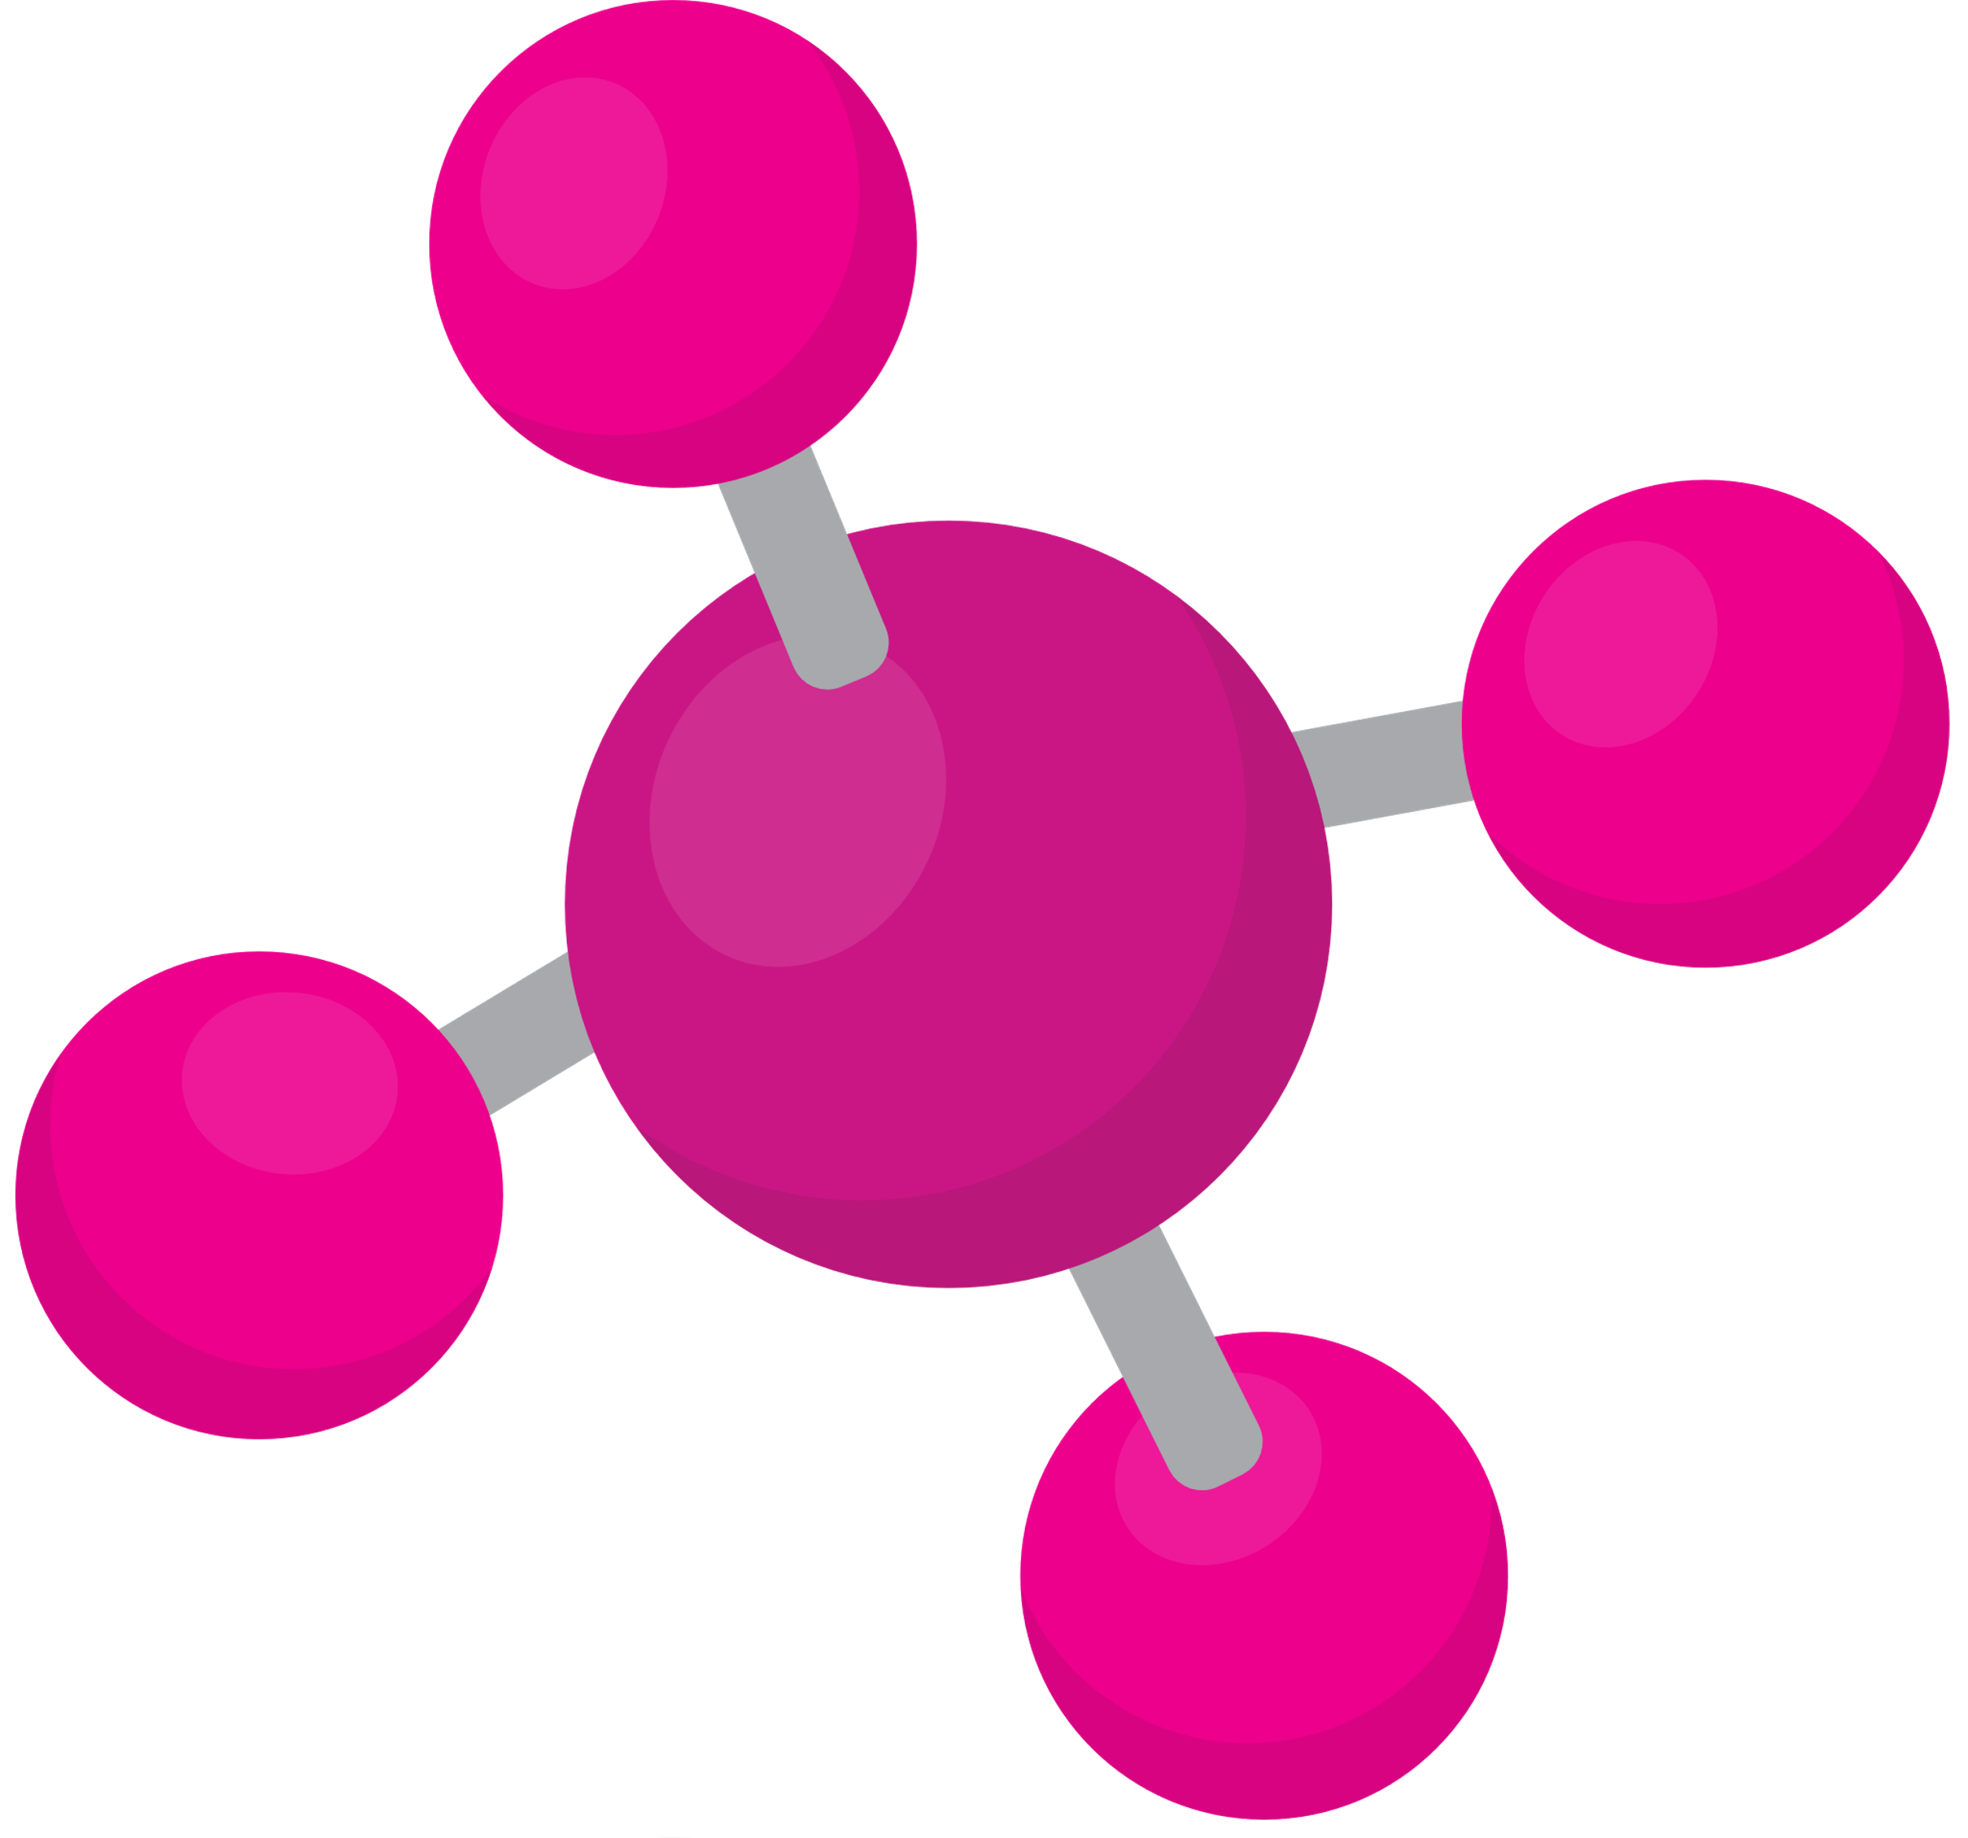
FRUIT & VEG MONTH 2023 - PPT3
EXPERIMENTS

Slide 2
WHAT IS AN EXPERIMENT?
In an experiment you answer a question. For example:
What will happen if...
What is the best way to...

Slide 3
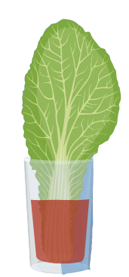

SO FOR EXAMPLE
What will happen if ...
....we put a cabbage leaf
in coloured water?
....we compare a cabbage leaf, celery stem and white flower? Which one absorbs the most colour?

Slide 4
IN AN EXPERIMENT YOU FOLLOW THE 'SCIENTIFIC METHOD'
In an experiment, you have to work and observe carefully and write everything down (your data).First think about what you want to know, and then how you can test it.
Then: What will you need? What will you measure?
When following the scientific method, you:
  Think of your question: what do you want to know?
  Write down what you think will happen
  Make a plan for your experiment, gather everything you need and start your experiment
  Carefully gather your data: write down your measurements and observations
  When finished, you can write your findings. Look at your data and observations and see if your can answer your question from step 1.
  Look at what you thought would happen in step 2: did that happen? Or was it different?
  Share and discuss your findings

Slide 5
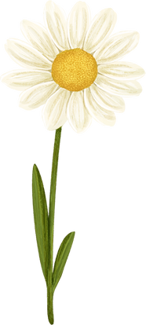
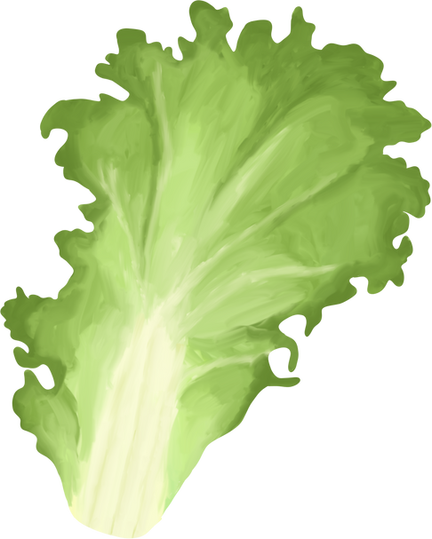



SCIENTIFIC METHOD EXAMPLE
1. Think of your question: what do you want to know?
What happens when you put a cabbage leaf, celery stem or white flower in coloured water?
2. Write down what you think will happen
I think they will turn the colour of the water. I think it will take a few days. I think the cabbage leaf will turn colour the fastest.
3. Make a plan for your experiment, gather everything you need and start your experiment
I will measure 3 times (once per day, so 3 days total)
  How much water is in the cup
  How much time has the cabbage, celery or flower been in the water
  The colour of the cabbage, celery or flower
I will need:
  A cup with coloured water
  A cabbage leaf, celery stem or a white flower
  My worksheet to make notes on

Slide 6
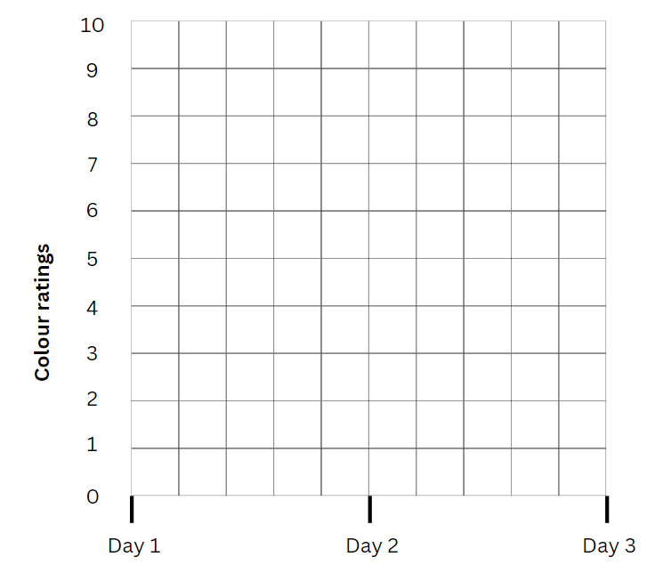
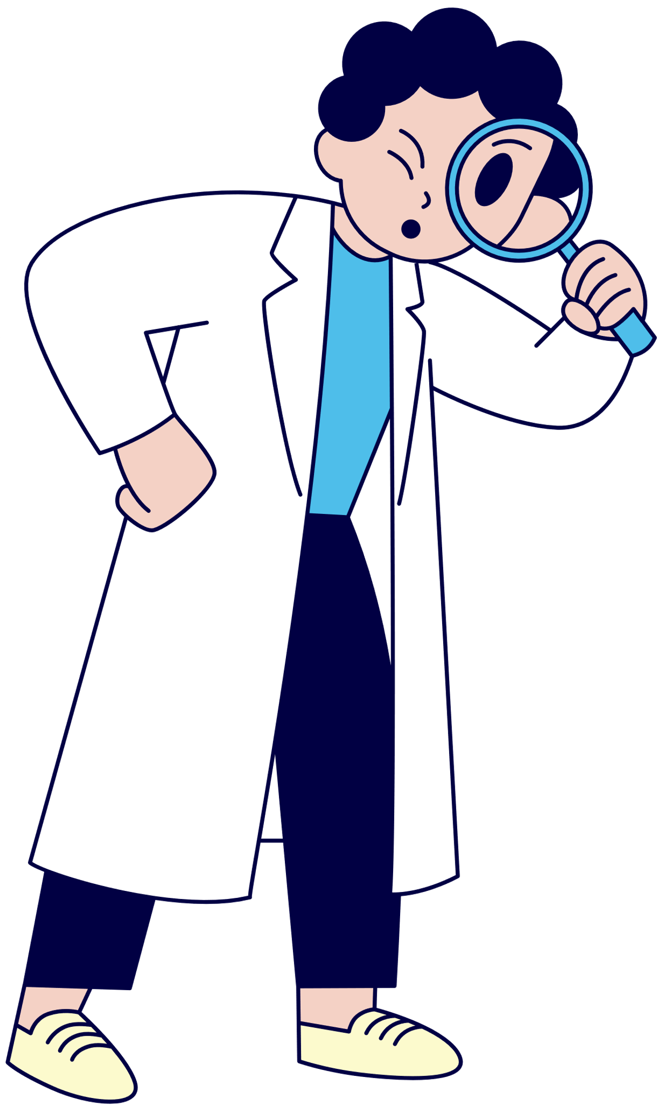

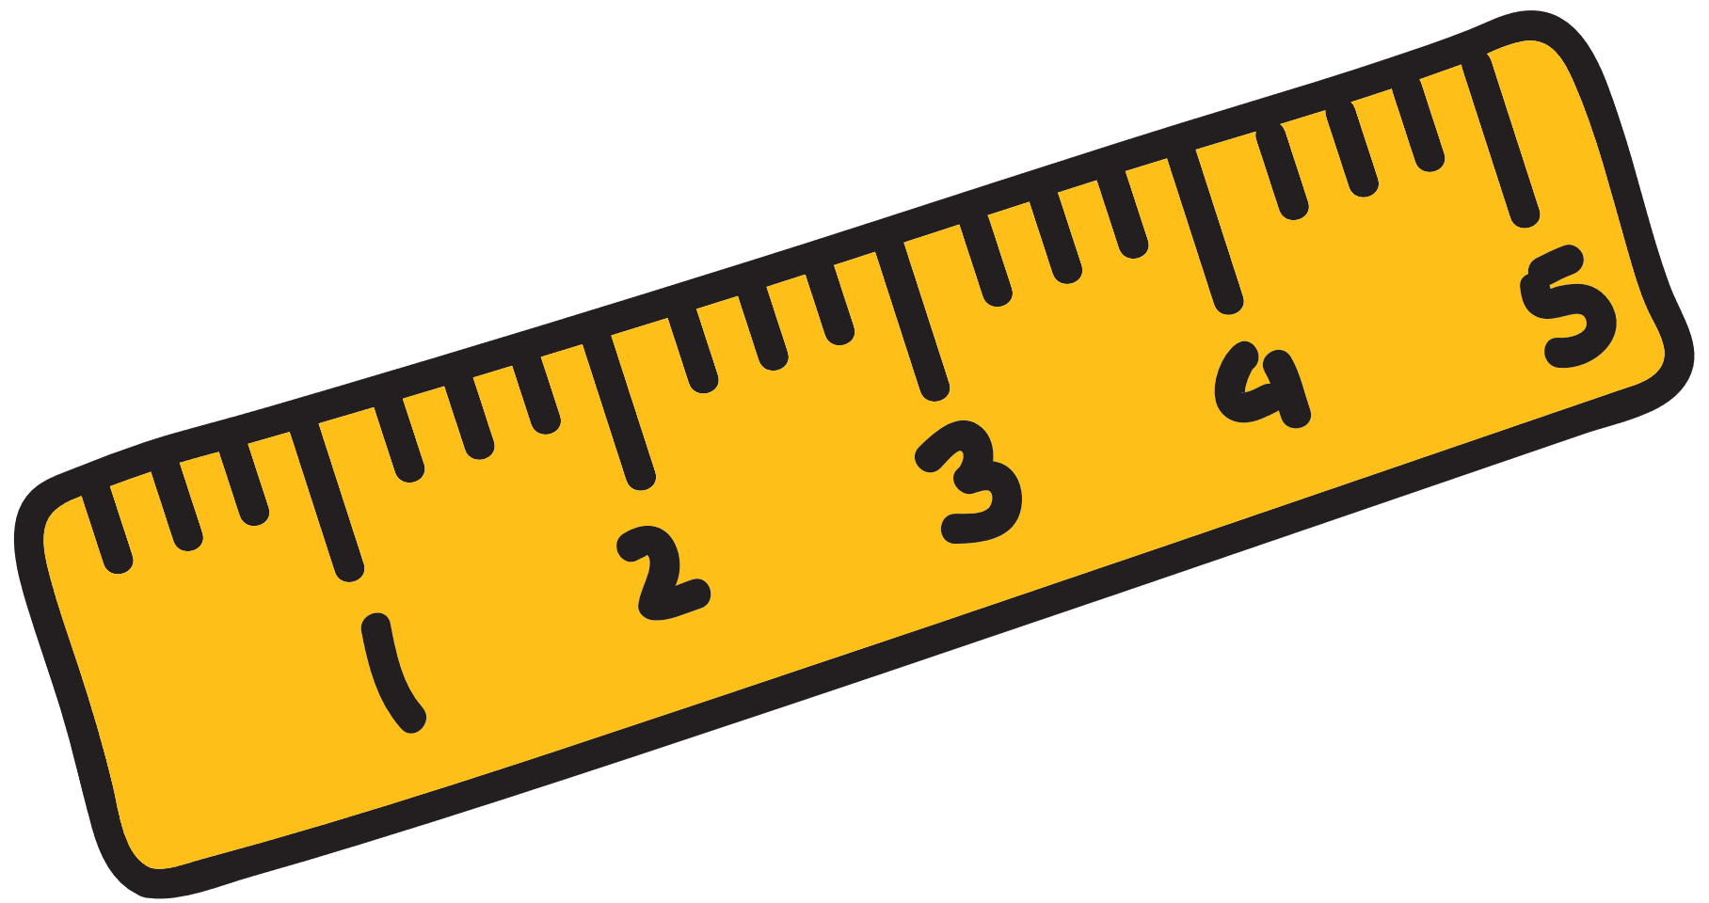
SCIENTIFIC METHOD EXAMPLE
4. Carefully gather your data: write down your measurements and observations
I use my worksheet to make careful observations.
After 3 days, I can even put my findings in a graph!

Slide 7
SCIENTIFIC METHOD EXAMPLE
5. When finished, you can write your findings. Look at your data and observations and see if your can answer your question from step 1.
I look back at my worksheets and check if anything happened to the colour of my leaf, cabbage or flower
I might have to compare my findings to those from another group, so I can be sure. I write my conclusion: a short summary of what happened and which one was the fastest to turn colour: the cabbage, flower or celery stem.
6. Look at what you thought would happen in step 2: did that happen? Or was it different?
I checked my observations and findings. I was correct in what I thought, but some people in my class had different
findings. That's why its important to tell others about what I found, in step 7.
7. Share and discuss your findings
The world should know what I found! Maybe we can also talk about WHY I found what I found.
Or maybe someone else wants to ask another question and test that in an experiment.
Can YOU think of another question?

